Slide 1





CORONA VIRUS ANALYSIS
BY: MARJORIE CALIMOSO

Slide 2

PROJECT OVERVIEW
The CORONA VIRUS pandemic has had a significant impact on public health and has created an urgent need for data-driven insights to understand the spread of the virus.
In this project, we aimed to analyze corona virus dataset all over the world using MySQL. The data set includes Province, Country/Region, Longitude, Latitude, Date, Confirmed, Deaths and Recovered Cases.
The goal is to answer 16 major issue statements using SQL queries related to the dataset that will guide strategic decisions and optimize the status of corona virus around the world.
2

Slide 3
PROJECT OBJECTIVE
To analyze corona virus status in the world by writing SQL queries to extract relevant insights from the dataset.
2

Slide 4
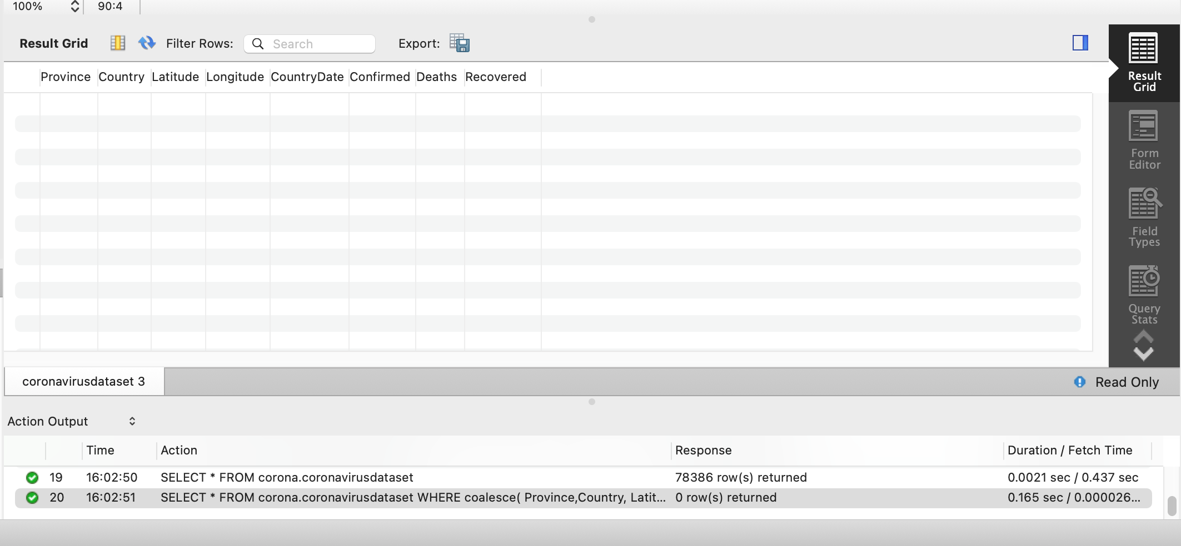
DATA ANALYSIS
Question No. 1
Write a code to check NULL values
Query:
Result Preview
SELECT * FROM corona.coronavirusdataset WHERE coalesce( Province, Country, Latitude, Longitude, CountryDate, Confirmed,
Deaths, Recovered) IS NULL;
2

Slide 5
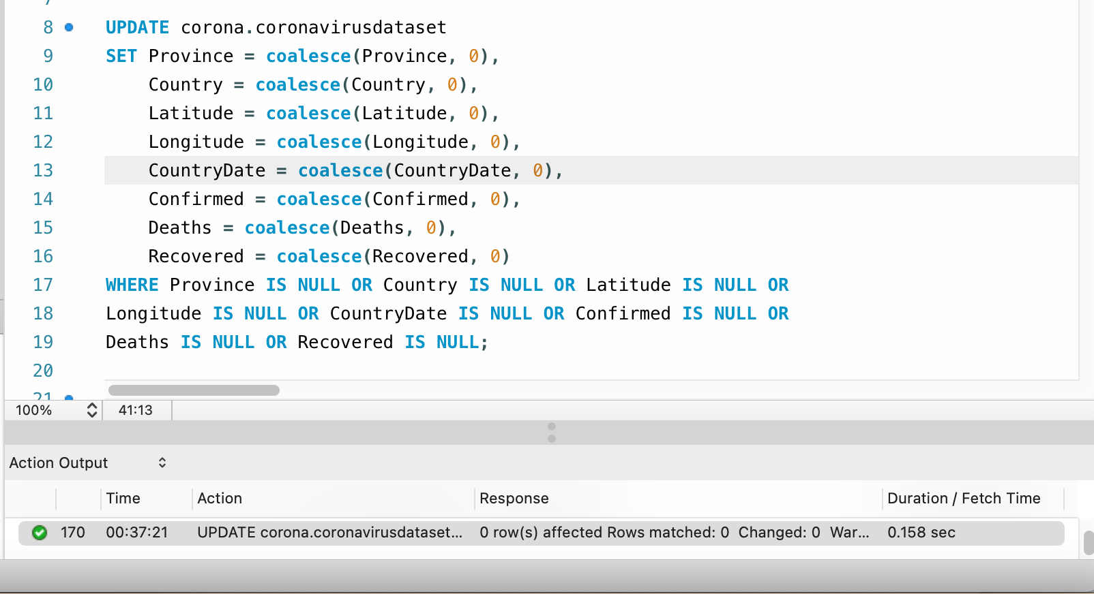
DATA ANALYSIS
Question No. 2
If NULL values are present, update them with zeros for all columns
Query
Result Preview
2

Slide 6
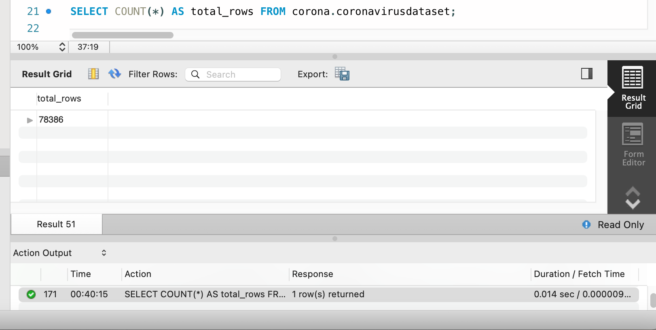
DATA ANALYSIS
Question No. 3
Check total number of rows
Query
Result Preview
2

Slide 7
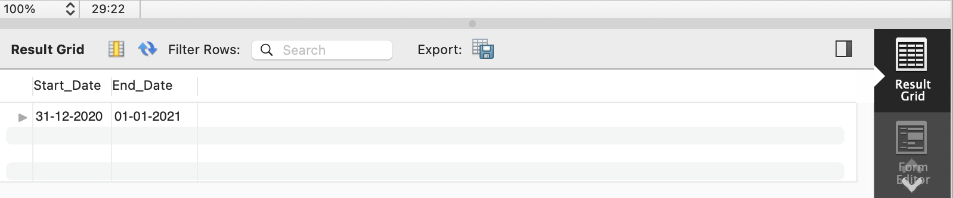
DATA ANALYSIS
Question No. 4
Check what is start_date and end_date
Result Preview
Query:
SELECT MIN(CountryDate) AS Start_Date, MAX(CountryDate) AS End_Date FROM
corona.`coronavirusdataset`;
2

Slide 8
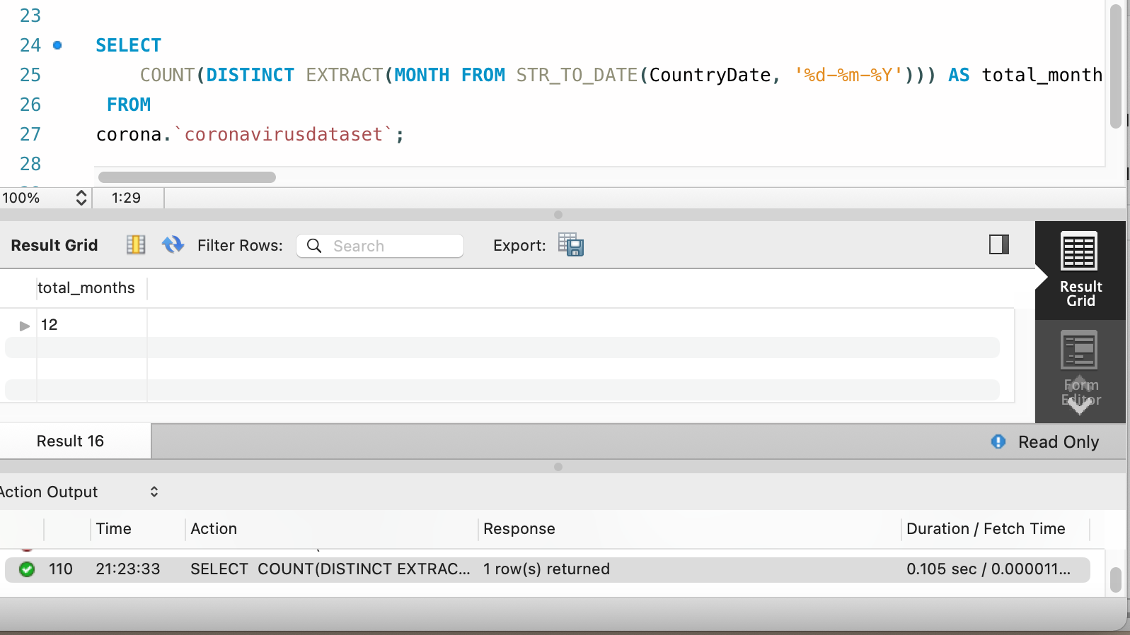
DATA ANALYSIS
Question No. 5
Number of month present in dataset
Query
Result Preview
2

Slide 9
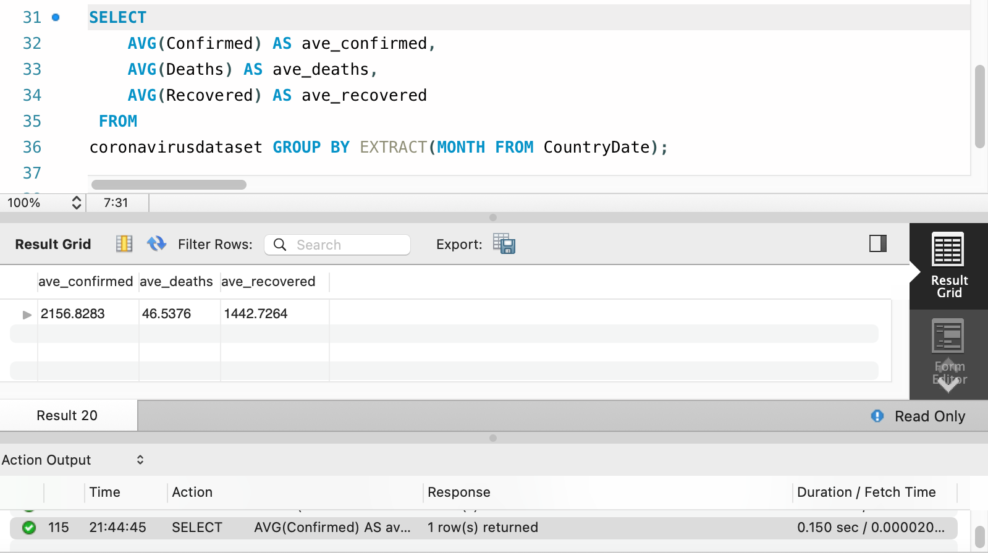
DATA ANALYSIS
Question No. 6
Find monthly average for confirmed, deaths, recovered
Query
Result Preview
2

Slide 10
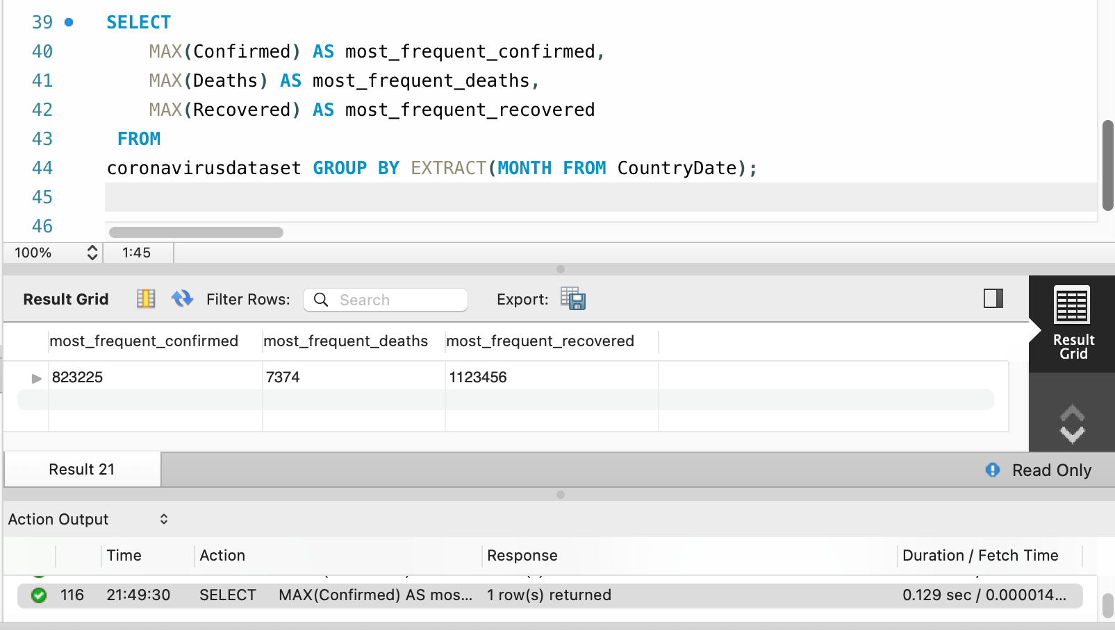
DATA ANALYSIS
Question No. 7
Find most frequent value for confirmed, deaths, recovered each month
Query
Result Preview
2

Slide 11
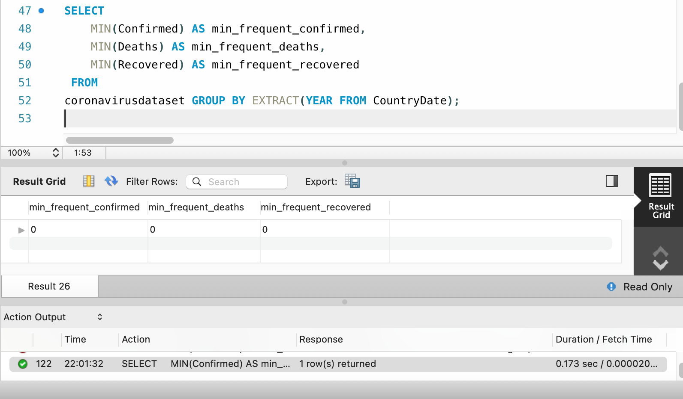
DATA ANALYSIS
Question No. 8
Find minimum values for confirmed, deaths, recovered per year
Query
Result Preview
2

Slide 12
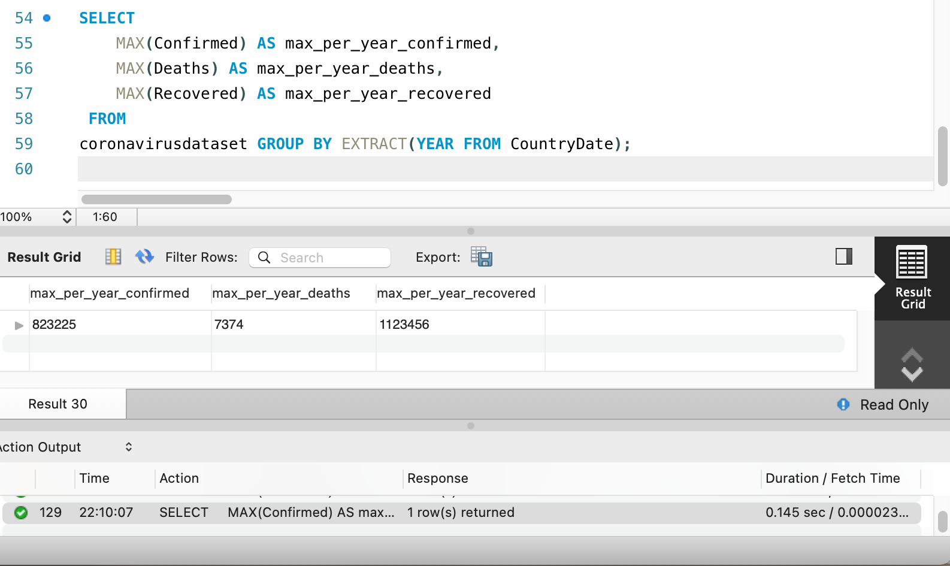
DATA ANALYSIS
Question No. 9
Find maximum values of confirmed, deaths, recovered per year
Query
Result Preview
2

Slide 13
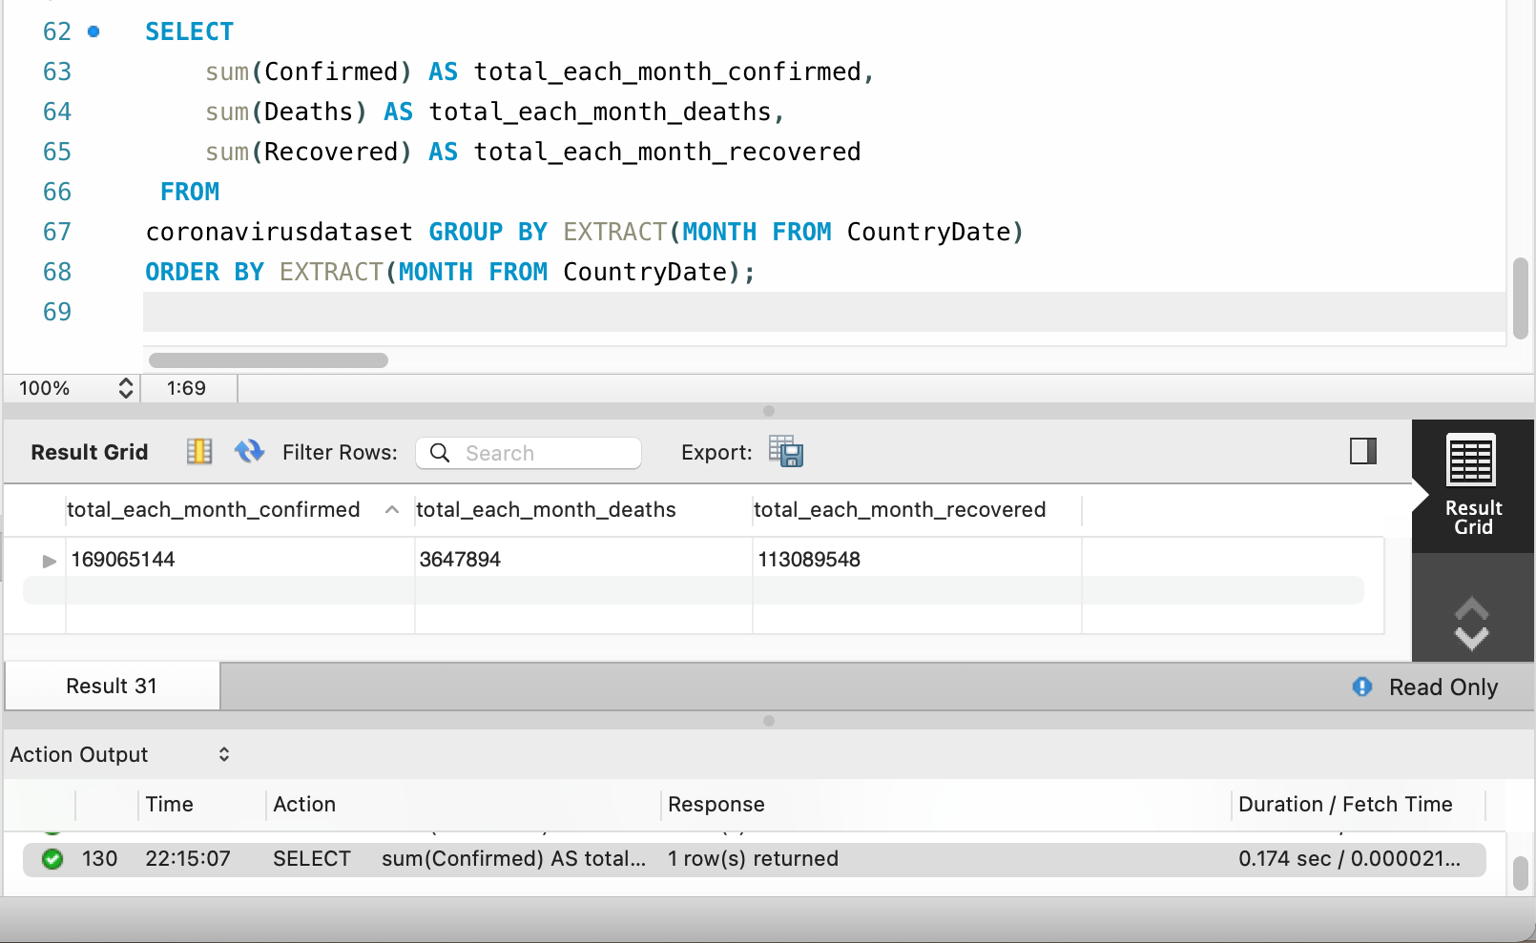
DATA ANALYSIS
Question No. 10
The total number of case confirmed, deaths, recovered each month
Query
Result Preview
2

Slide 14
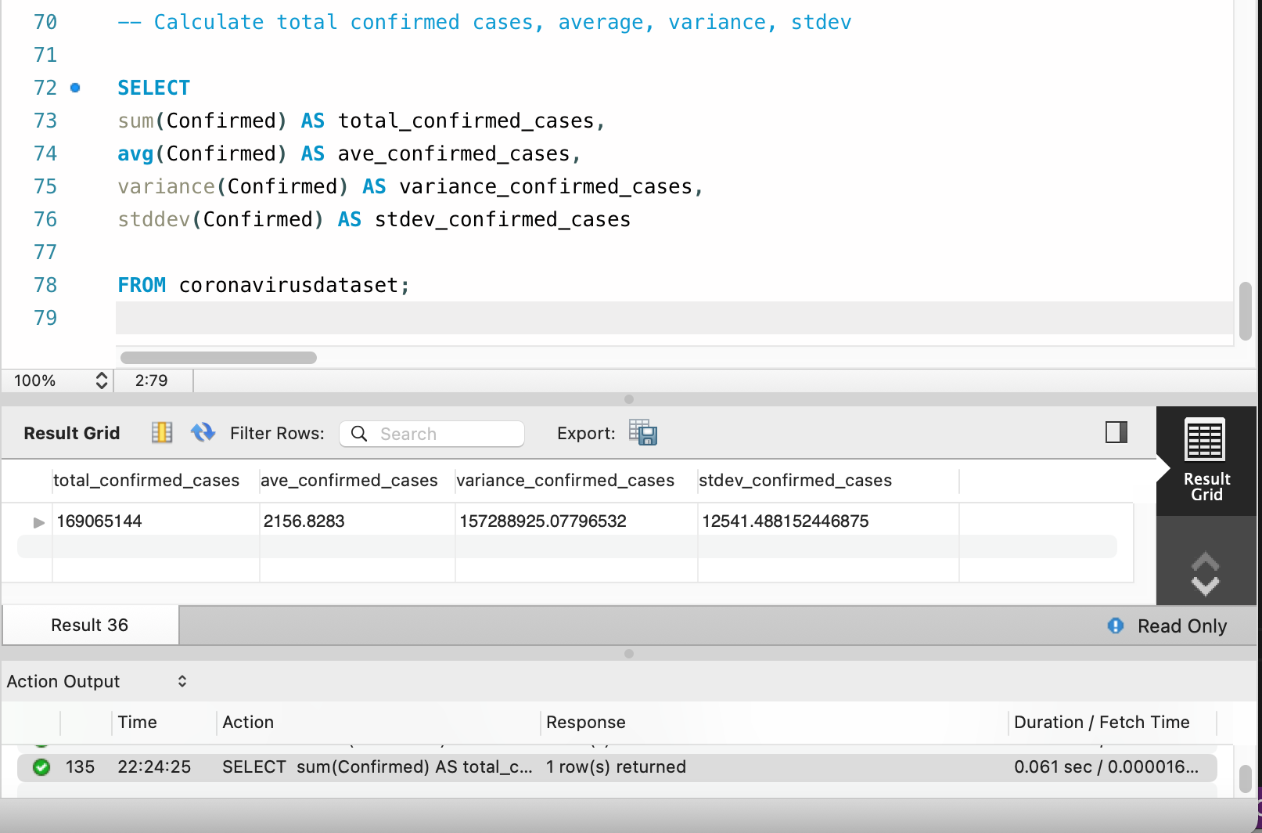
DATA ANALYSIS
Question No. 11
Check how corona virus spread out with respect to confirmed case
(Eg.: total confirmed cases, their average, variance & STDEV )
Query
Result Preview
2

Slide 15
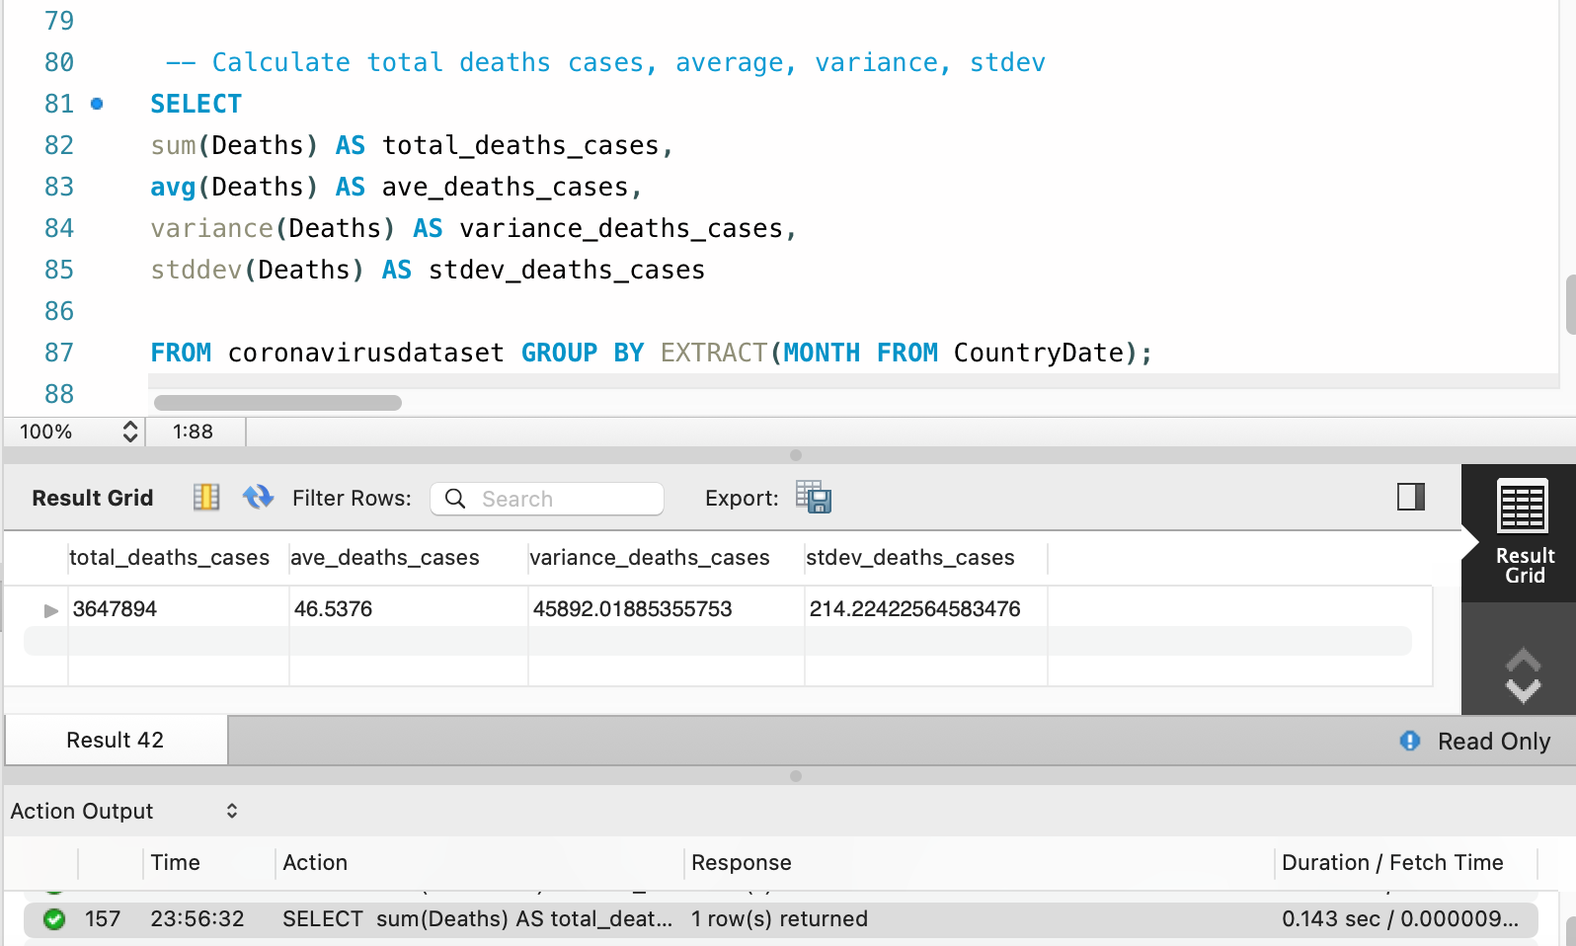
DATA ANALYSIS
Question No. 12
Check how corona virus spread out with respect to death case per month
(Eg.: total confirmed cases, their average, variance & STDEV )
Query
Result Preview
2

Slide 16
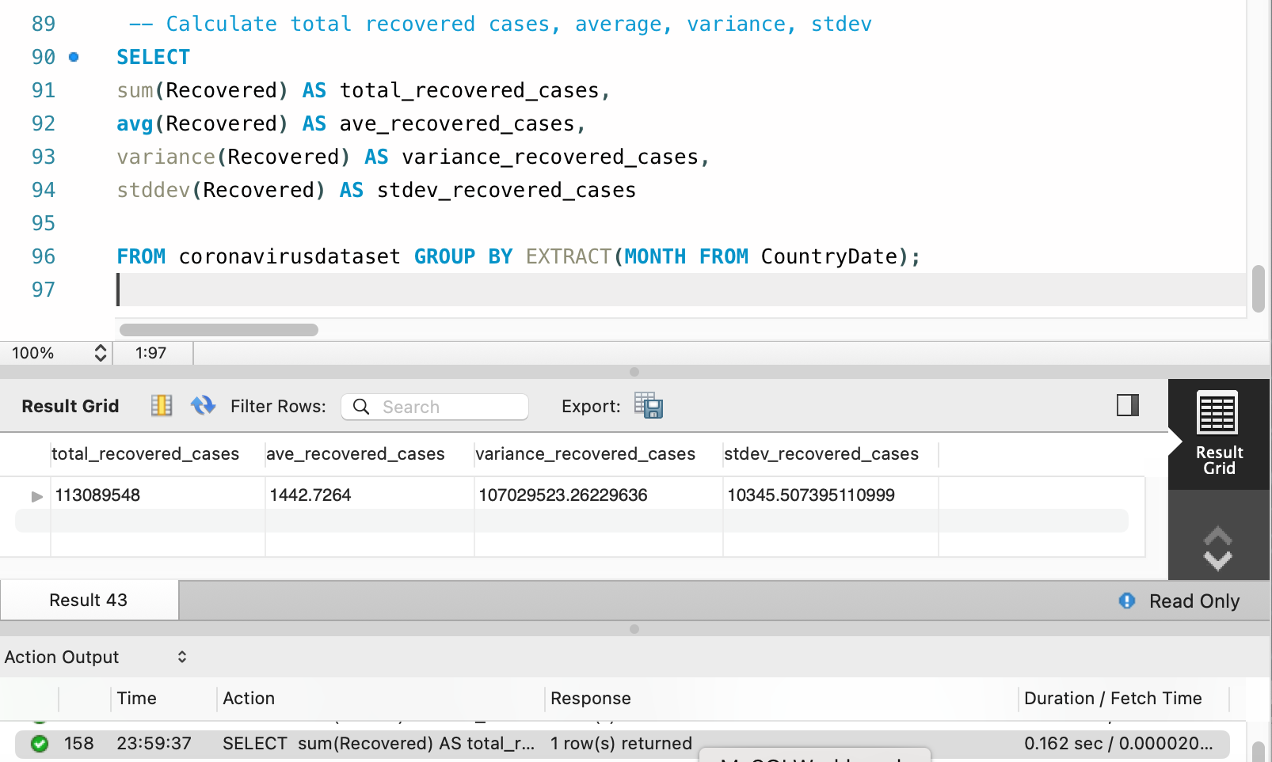
DATA ANALYSIS
Question No. 13
Check how corona virus spread out with respect to recovered case
(Eg.: total confirmed cases, their average, variance & STDEV )
Query
Result Preview
2

Slide 17
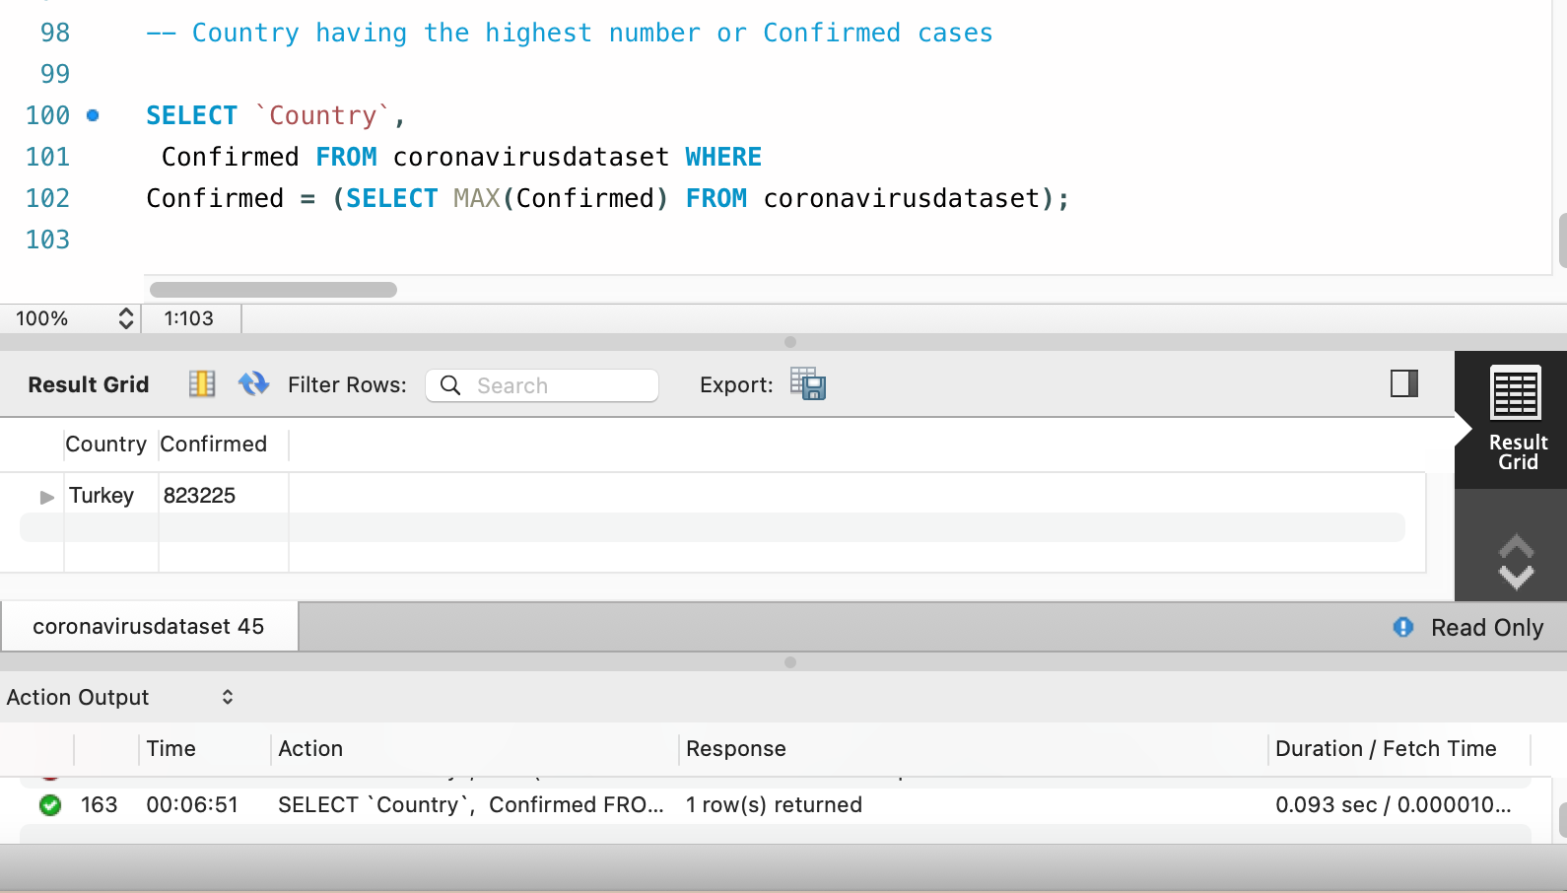
DATA ANALYSIS
Question No. 14
Find Country having highest number of the Confirmed case
Query
Result Preview
2

Slide 18
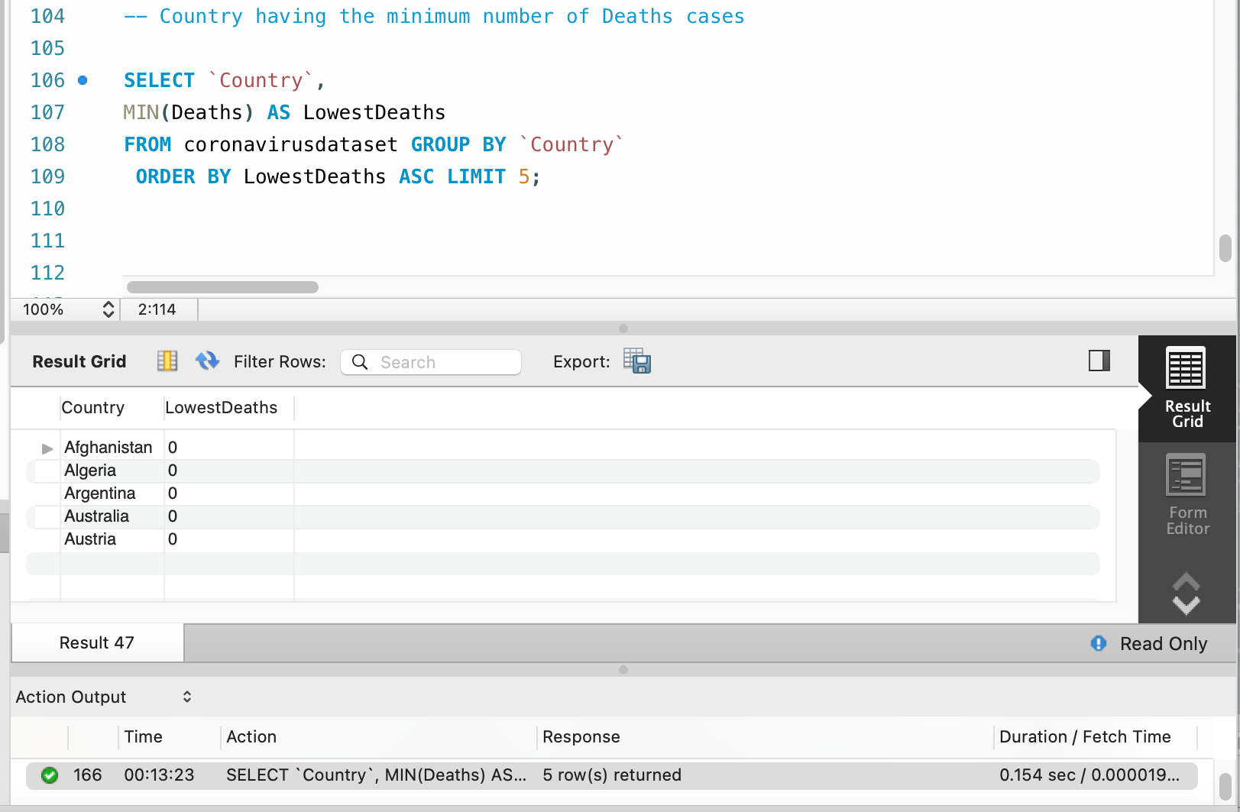
DATA ANALYSIS
Question No. 15
Find Country having lowest number of the death case
Query
Result Preview
2

Slide 19
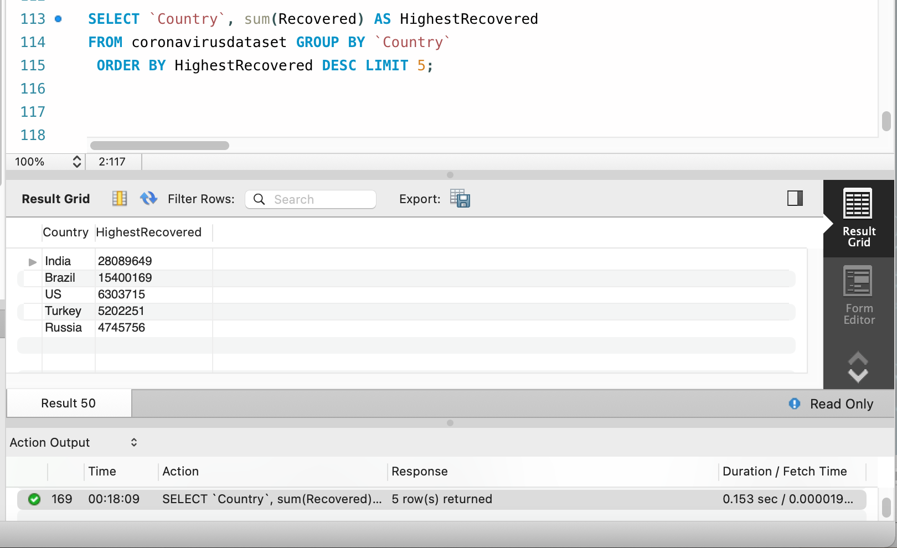
DATA ANALYSIS
Question No. 16
Find top 5 countries having highest recovered case
Query
Result Preview
2

Slide 20
OVERALL INSIGHTS
The dataset does not contain NULL values
There are 78,386 rows in the dataset
The start date of corona virus is December 31, 2020 and end date is January 01, 2021 according from the dataset
There are 12 months in the dataset
The monthly average for confirmed cases is 2,156.8283, average deaths is 46.5376 and 1,442.7284 for recovered cases
The most frequent value each month in confirmed cases is 823,225, deaths 7,374 and in recovered cases is 1,123,456
There are no minimum values per year
The maximum values per year in confirmed cases is 823,225, deaths 7,374 and in recovered cases is 1,123,456
The total number of cases each month confirmed is 169,065,144, deaths 3,647,894 and recovered is 113,089,548
The total variance per month of confirmed cases is 157,288,925 and the STDEV is 12,541
The total variance per month of deaths is 45,892 and STDEV is 214
The total variance per month of recovered is 107,029,523 and STDEV is 10,345
The country having the lowest death cases is Afghanistan, Algeria, Argentina, Australia, and Austria
The top 5 countries having the highest recovered cases is India, Brazil, USA, Turkey, and Russia
2

Slide 21
RECOMMENDATIONS
To be continue
2

